Slide 1
MLA Formatting
~
In-text Citations
for articles and books
© Laura Torres 2014 All rights reserved. www.lauratorres.com

Slide 2
You MUST include an in-text citation ANY time you use information from an outside source, whether it is paraphrase or a direct quote.

Slide 3
An in-text citation appears in parentheses at the end of the sentence.
The study showed more than a ten percent increase (Smith 22).

Slide 4
The in-text citation begins with the author’s last name
(Smith 22)

Slide 5
If a page number is available, list it after the author’s name. Do not use a comma between the name and page number.
(Smith 22)

Slide 6
If there are two or three authors, list them all.
(Smith and Luke 22)
(Smith, Luke, and Perro 22)

Slide 7
If there are more than three authors, use the first author’s last name and
“et al.” which means “and others.”
(Smith et al. 22)

Slide 8
If your source does not include the author’s name, use the name of the organization that produced the source.
(USDA 22)

Slide 9
If the organization is not credited as the author, use the title of the source. Titles are always in quotation marks
(“Obesity Rates in Children” 22)

Slide 10
If the title is lengthy, you can use the first few words for brevity.
(“Obesity Rates” 22)

Slide 11
If the source does not include a page number, leave it off. Do not assign your own page numbers.
(Smith)

Slide 12
If you are using more than one source from an author, use the title after the author to avoid confusion.
(Smith, “Obesity Rates” 22)

Slide 13
If you mention the name of the author in the sentence, you do not need to repeat it in the citation
According to Smith, obesity rates are rising (22).

Slide 14
If the citation follows a direct quote, punctuation goes outside the quotation marks after the citation.
The results were “highly unusual” (Smith 22).

Slide 15
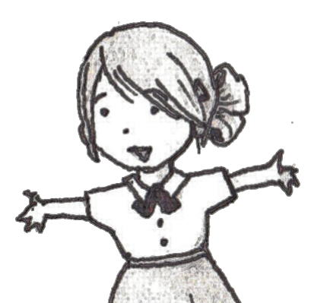
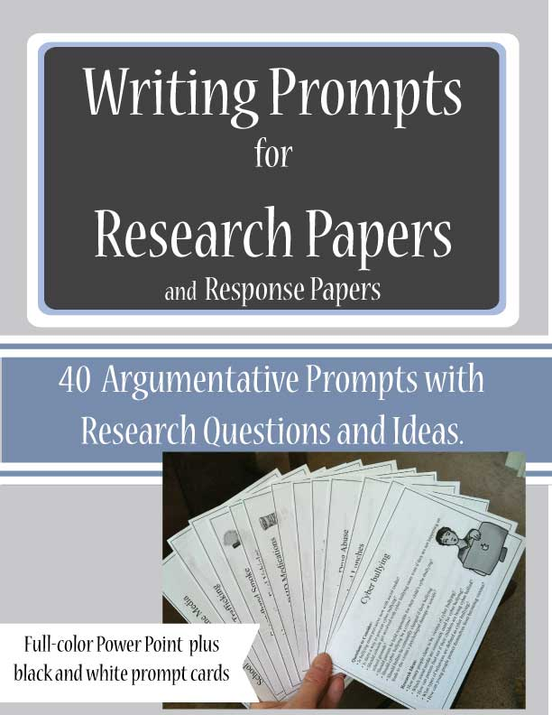
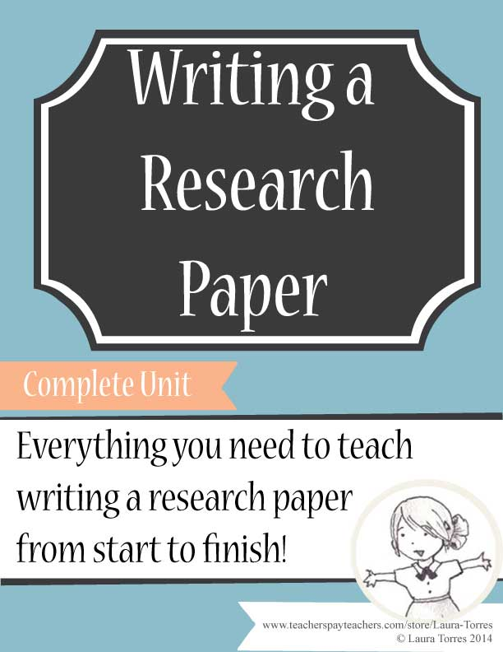
The End
~
Thank you for purchasing this product.
© Laura Torres 2014 The original purchaser of this document is granted permission to reproduce the pages in needed quantities for the purchaser's classroom only. Minor editing is allowed; the document remains under copyright even when edited. Duplication for other classes or by other teachers or for use in wide distribution as within a school district or on the internet in any form is strictly forbidden. Violations are subject to the penalties of the Digital Millennium Copyright Act.
Visit my store for more ideas and resources
www.teacherspayteachers.com/Store/Laura-Torres

